Slide 1
Directional Sound Detection

Slide 2
Key Objectives:
Detect Sound Direction:
Use multiple microphones arranged in a specific geometry to capture incoming sound waves.
Measure differences in arrival time between microphones.
Process Signals Using Analog Circuits:
Use amplifiers to boost microphone signals.
Implement band-pass filters to isolate relevant sound frequencies.
Design comparator circuits to analyze phase shifts or intensity variations.
Indicate Direction:
Use voltage-controlled indicators ( LED )to show the direction of the sound source.

Slide 3
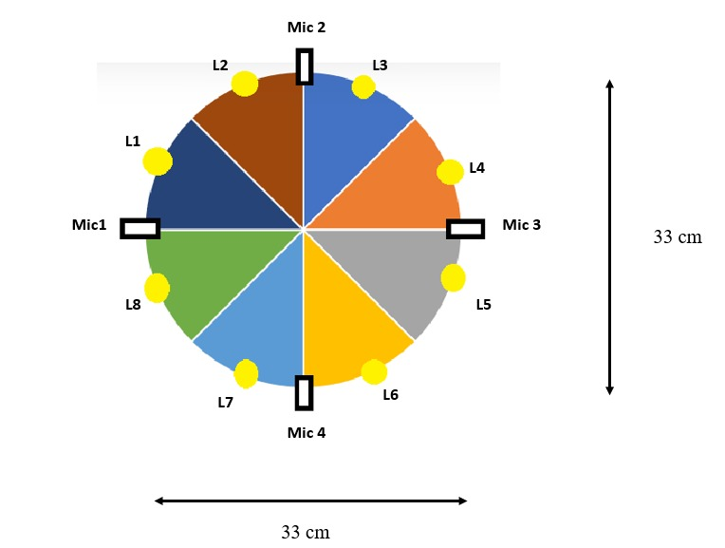
Mic and LED Placement

Slide 4
Truth Tables for Selection
SR 1
M1<M3
0 | 3,4,5,6
1 | 1,2,7,8
SR 2
M2<M4
0 | 5,6,7,8
1 | 1,2,3,4
Combinational Circuit
M1<M3 | M2<M4 | Output Led
0 | 0 | 5,6
0 | 1 | 3,4
1 | 0 | 7,8
1 | 1 | 1,2

Slide 5
Truth Tables for Selection
SR 3
M3<M4
0 | 6
1 | 5
SR 4
M2<M3
0 | 4
1 | 3
SR 5
M4<M1
0 | 8
1 | 7
SR 6
M1<M2
0 | 2
1 | 1

Slide 6
Truth Table
INPUT |  |  | OUTPUT
C1 | C2 | M | LED
0 | 0 | 0 | 6
0 | 0 | 1 | 5
0 | 1 | 0 | 4
0 | 1 | 1 | 3
1 | 0 | 0 | 8
1 | 0 | 1 | 7
1 | 1 | 0 | 2
1 | 1 | 1 | 1

Slide 7
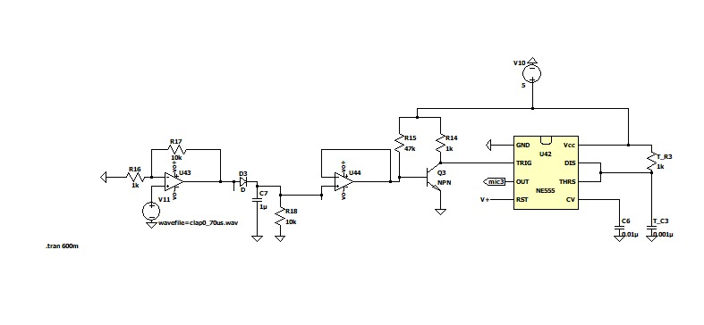
Module 1 - Input

Slide 8
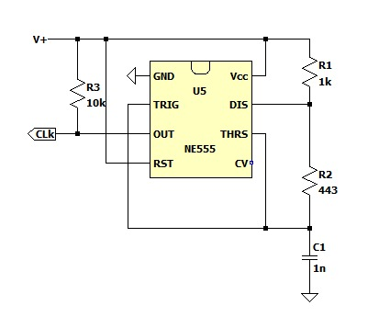
Module 2 – Clock

Slide 9
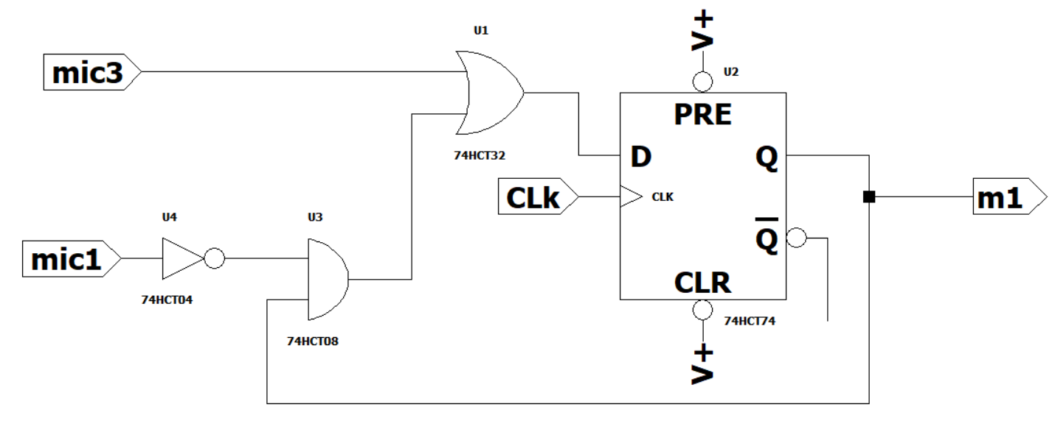
Module 3 – Flip Flop

Slide 10
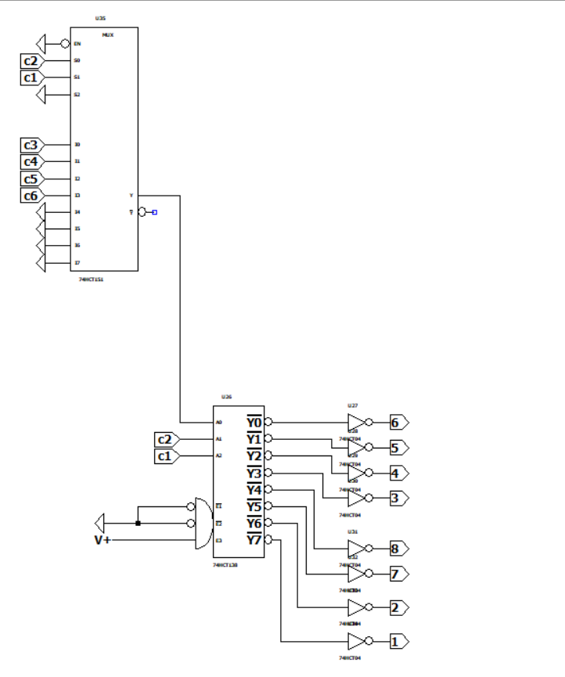
Module 4 - Output

